Slide 1


Department of Artificial Intelligence and Data
Science
CardioAI: Enhancing Heart Attack Detection in Diabetic Patients Through ECG Analysis
Mrs Y.Nirmala Anandhi AP
AI&DS DEPT
BENJAMIN NICOLAS S
(221801005)
CHARLESS BINNY K
(221801007)

Slide 2
Problem Statement and Motivation
The goal of this project is to automate the detection of myocardial infarction from ECG images by leveraging deep learning techniques. The proposed model will take ECG images as input and classify whether the patient is suffering from myocardial infarction or not. By focusing on both diabetic and non-diabetic individuals, the model will aim to provide an effective diagnostic tool that is sensitive to the unique cardiovascular characteristics of diabetic patients.
MOTIVATION:
To predict cardiovascular risk faced by patients with diabetes, there's a critical need for more accurate prediction tools. By leveraging deep learning, this project seeks to enhance risk prediction, enabling better clinical decisions and personalized care for improved patient outcomes.

Slide 3
Objectives
Collect and preprocess a dataset of ECG images from diabetic patients and patients with myocardial infarction to ensure quality and uniformity for analysis..
Develop a deep learning model (e.g., convolutional neural network) to analyze the ECG images and classify the presence of myocardial infarction
Train the model on the prepared dataset, employing techniques such as cross-validation to assess its performance and generalizability.
Evaluate the model's effectiveness using metrics like accuracy, precision, recall, F1 score, and AUC-ROC, providing insights into its potential clinical applications for diagnosing myocardial infarction.

Slide 4
Abstract
Cardiovascular diseases, particularly myocardial infarction, present significant health risks, especially for diabetic patients. This project aims to develop a machine learning model for the early detection of myocardial infarction by analyzing electrocardiogram (ECG) images. Using a comprehensive dataset of ECG images from diabetic patients and those diagnosed with myocardial infarction, the project employs advanced image preprocessing techniques to enhance data quality. A convolutional neural network (CNN) extracts relevant features from the ECG images, enabling the classification of patients based on myocardial infarction presence. The model's performance is assessed using accuracy, precision, recall, F1 score, and AUC-ROC metrics, establishing its effectiveness as a diagnostic tool. By automating ECG analysis, this project seeks to improve patient outcomes through timely detection, with findings that will emphasize the model's capabilities, particularly for diabetic patients, and suggest future research directions in cardiovascular disease management.

Slide 5
Introduction and Overview of the Project.
Introduction:
Cardiovascular diseases, particularly myocardial infarction (MI), are leading causes of death worldwide, with diabetic patients at higher risk due to their increased susceptibility to cardiovascular complications. Early detection of MI is critical for improving outcomes and preventing severe consequences. Traditional ECG interpretation can be time-consuming and prone to human error, prompting interest in using machine learning to automate ECG analysis. This approach offers a more efficient and reliable method for detecting MI, particularly in high-risk groups like diabetic patients.

Slide 6
Introduction and Overview of the Project.
Overview of the Project:
This project aims to develop a machine learning model for early detection of myocardial infarction (MI) by analyzing ECG images, with a focus on diabetic and MI-diagnosed patients. The process begins with collecting and preprocessing a comprehensive ECG dataset to improve image quality and standardize inputs. A convolutional neural network (CNN) will extract key features from the ECG images to classify the presence of MI. The model’s performance will be evaluated using metrics like accuracy, precision, recall, F1 score, and AUC-ROC. Automating ECG analysis can enhance early detection, improve patient outcomes, and guide future research in cardiovascular care.

Slide 7
Literature Survey
S.No | Author Name | Paper Title | Description | Jornal | Volume/ Year
1 | Simarjeet Kaur, Jimmy Singla, Lewis Nkenyereye, Sudan Jha, Deepak Prashar, Gyanendra Prasad Joshi | Medical Diagnostic Systems Using Artificial Intelligence (AI) Algorithms: Principles and Perspectives. | This paper reviews the application of AI techniques such as Fuzzy Logic, Machine Learning, and Deep Learning in medical diagnostics. It analyzes discusses the most commonly used AI techniques in medical diagnostics, and provides insights into diseases like heart disease, brain disease, prostate, liver disease, and kidney disease. | IEEE journal | volume 8, 2020
2 | F. El-Sofany | Predicting Heart Diseases Using Machine Learning and Different Data Classification Techniques | This paper investigates the use of machine learning (ML) techniques for predicting heart disease. The study evaluates ML classifiers, including Naive Bayes, Support Vector Machine (SVM), and XGBoost, alongside feature selection methods such as chi-square, ANOVA, and mutual information. Through analysis, XGBoost emerged as the top-performing classifier | IEEE jornal | volume 12, 2024
3 | Vineet Kumar, Ankit Saxena, Vikas Singh | An Effective Heart Disease Prediction Model for a Clinical Decision Support System | This research article presents the development of a Heart Disease Prediction Model aimed at enhancing clinical decision support systems. The study utilizes advanced machine learning techniques as DBSCAN, SMOTE-ENN, and XGBoost to improve the accuracy of heart disease predictions. The model is tested on public datasets, demonstrating significant improvements in prediction accuracy compared to traditional model

Slide 8
Literature Survey
S.No | Author Name | Paper Title | Description | Jornal | Volume/ Year
4 | Marcello Casaccia Bertoluci and Viviane Zorzanelli Rocha | Cardiovascular risk assessment in patients with diabetes | This review addresses the assessment of cardiovascular disease risk in diabetic patients using traditional and non-traditional risk factors. It emphasizes the importance of stratifying patients to improve the accuracy of predicting CVD .The review also discusses the use of new tools for risk reclassification and the potential cardiovascular benefits of newer glucose control drugs such as SGLT-2 inhibitors and GLP-1 agonists | Diabetology & Metabolic Syndrome | Volume 9, 2017
5 | Huazhong Yang,Zhongju Chen,Huajian Yang,Maojin Tian | Predicting Coronary Heart Disease Using an Improved LightGBM Model: Performance Analysis and Comparison | The paper titled "Predicting Coronary Heart Disease Using an Improved LightGBM Model: Performance Analysis and Comparison" likely focuses on enhancing the prediction accuracy of coronary heart disease (CHD) using an advanced version of the LightGBM (Light Gradient Boosting Machine) model. Here’s a general description of the paper: | IEEE journal | volume11, 2023

Slide 9
Existing System
Currently, the detection of myocardial infarction (MI) primarily relies on manual interpretation of electrocardiogram (ECG) signals by healthcare professionals. Cardiologists analyze the ECG waveforms, focusing on key features such as the P wave, QRS complex, and T wave, to detect abnormalities indicative of MI. While this method is effective in many cases, it has limitations, including the need for expert knowledge, potential human error, and variability in interpretation. Additionally, for diabetic patients, ECG patterns may be more complex, making diagnosis more challenging.
In recent years, some automated systems and algorithms have been developed to assist in ECG analysis, using techniques like signal processing and traditional machine learning methods, such as support vector machines (SVM) and decision trees. However, these methods often require manual feature extraction, limiting their adaptability and accuracy, particularly for more complex cases like diabetic patients with cardiovascular complications.

Slide 10
Drawback of Existing System
Dependency on Expert Interpretation: The current system relies heavily on the expertise of cardiologists for analyzing ECG signals, which can lead to delays in diagnosis, especially in resource-limited settings. Variability in skill and experience may also affect the accuracy of interpretation.
Potential for Human Error: Manual analysis of ECG signals is prone to human error, which can result in misinterpretation of critical heart conditions, especially subtle or atypical signs of MI, leading to delayed or incorrect diagnoses.
Limited Scalability: The manual approach is not easily scalable, as each ECG needs to be individually reviewed by healthcare professionals. This can create bottlenecks, particularly in emergency situations or when dealing with a large volume of patients..

Slide 11
Proposed System
Automated ECG Analysis:The system uses a CNN-based architecture to automatically process ECG images, eliminating the need for manual feature extraction. This allows the model to identify complex patterns and anomalies in ECG waveforms that may be indicative of myocardial infarction.
Specialization for Diabetic Patients:The model is designed to handle the unique ECG characteristics of diabetic patients, who are at higher risk for cardiovascular complications. By incorporating data from diabetic patients, the system aims to improve diagnostic accuracy for this high-risk group.
Improved Accuracy and Consistency:The CNN can learn from large datasets of ECG images, allowing it to detect subtle abnormalities with high precision and consistency. This reduces the variability and potential for human error present in traditional manual interpretation.

Slide 12
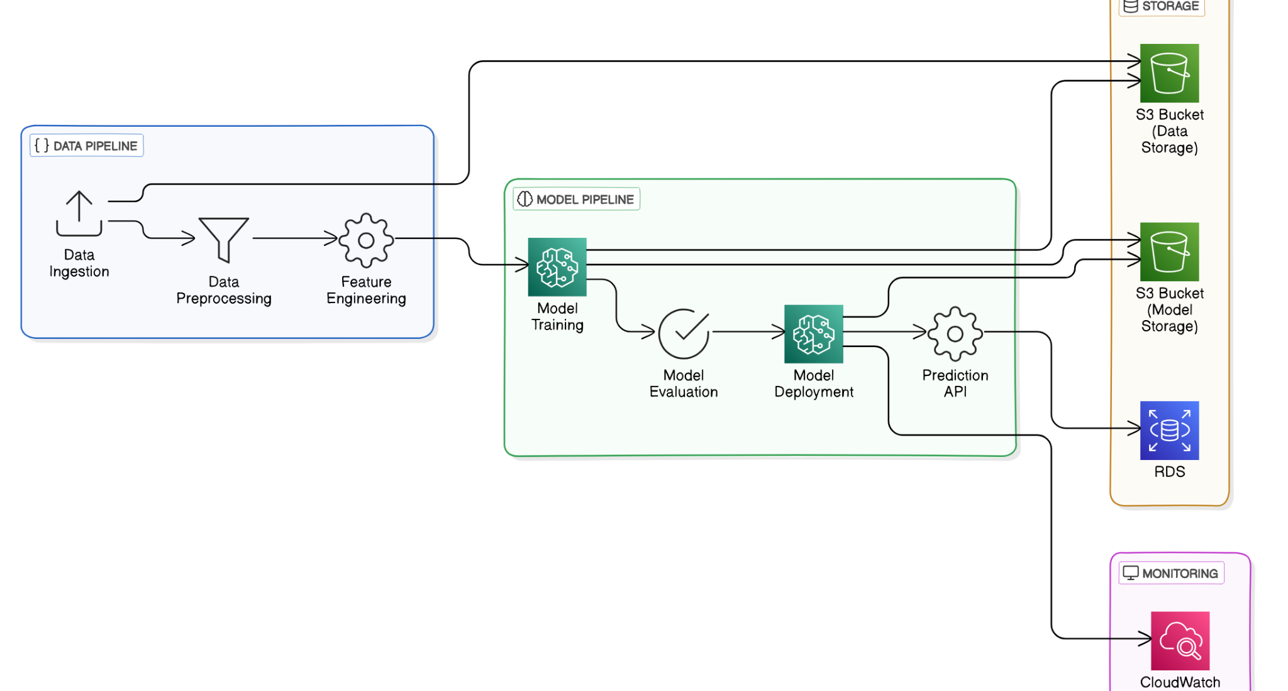
System Architecture

Slide 13
List of modules
Image Preprocessing and Data Augmentation.
Feature Extraction with Pre-trained VGG16Gradient Boost based Model Training .
Custom Model Layers and Binary Classification.
Model Compilation, Training, and Evaluation.
Model Saving and Deployment.

Slide 14
Image Preprocessing and Data Augmentation
Load Pre-trained VGG16 Model
Freeze the Pre-trained Layers
Pass Preprocessed Images Through VGG16
Preprocessed image
Load
Pre-trained VGG16
Pass Images through Convolutional Layers
Freeze
Pre-trained Layers
Extracted Features from VGG16

Slide 15
Feature Extraction with Pre-trained VGG16
Load Pre-trained VGG16 Model
Freeze the Pre-trained Layers
Pass Preprocessed Images Through VGG16
Preprocessed image
Load
Pre-trained VGG16
Pass Images through Convolutional Layers
Freeze
Pre-trained Layers
Extracted Features from VGG16

Slide 16
Feature Extraction with Pre-trained VGG16
Preprocessed image
Load
Pre-trained VGG16
Freeze
Pre-trained Layers
Extracted Features from VGG16
Pass Images through Convolutional Layers

Slide 17

Custom Model Layers and Binary Classification
1.Add Custom Layers:
Add fully connected layers after VGG16.
Include layers like Dropout, Dense, and Batch Normalization.
2.Binary Classification Layer:
Add the final classification layer with 1 neuron and sigmoid activation for binary output
Extracted Features from VGG16
Custom Fully Connected Layers
Dropout Layer
Final Dense Layer with Sigmoid
Binary Output (Myocardial Infarction: Yes/No)

Slide 18
Custom Model Layers and Binary Classification
Extracted Features from VGG16
Custom Fully Connected Layers
Final Dense Layer with Sigmoid
Binary Output (Myocardial Infarction: Yes/No)
Dropout Layer

Slide 19
Model Compilation, Training, and Evaluation
dsd
Custom Model
Train-Test Split
Model Compilation (Adam, Binary Cross-Entropy)
Model Training
Model Evaluation on Test Data
Model Performance Metrics

Slide 20
Model Compilation, Training, and Evaluation
Custom Model
Train-Test Split
Model Training
Model Performance Metrics
Model Evaluation on Test Data
Model Compilation (Adam, Binary Cross-Entropy)

Slide 21
Model Saving and Deployment
diao
Trained Model
Save Model in .h5 format
Load Saved Model for Inference
Input New ECG Data
Predict Myocardial Infarction

Slide 22
Model Saving and Deployment
Trained Model
Save Model in .h5 format
Input New ECG Data
Predict Myocardial Infarction
Load Saved Model for Inference

Slide 23
References.
Comparison of Machine Learning Approaches Toward Assessing the Risk of
Developing Cardiovascular Disease as a Long-Term Diabetes Complication
IEEE Journal of Biomedical and Health Informatics ( Volume: 22, Issue: 5,
September 2018)
Kee OT, Harun H, Mustafa N, Abdul Murad NA, Chin SF, Jaafar R, Abdullah N. Cardiovascular complications in a diabetes prediction model using machine learning: a systematic review. Cardiovasc Diabetol. 2023 Jan 19;22(1):13. doi: 10.1186/s12933-023-01741-7. PMID: 36658644; PMCID: PMC9854013
A Methodology For Early Prediction and Classification of Heart Diseases in Diabetic Patients With Machine Learning Techniques 2022 IEEE 2nd International Conference on Mobile Networks and Wireless Communications (ICMNWC)

Slide 24
Thank You

Slide 25
